Slide 1
BROWNFIELD site assesments
Grant & Loan Basics
Heather Smith, Jackson District Brownfield Coordinator
SmithH29@michigan.gov
517-648-7987

Slide 2



Getting to know your Coordinator
Michigan native---Pigeon, a farming community in the tip of The Thumb
Spartan (Go Green!)
Extensive laboratory experience
  17 years at Fibertec Environmental Services (Laboratory Director)
I love traveling to places of natural beauty!
  Michigan
  California’s Highway 1
Backyard pets:

Slide 3
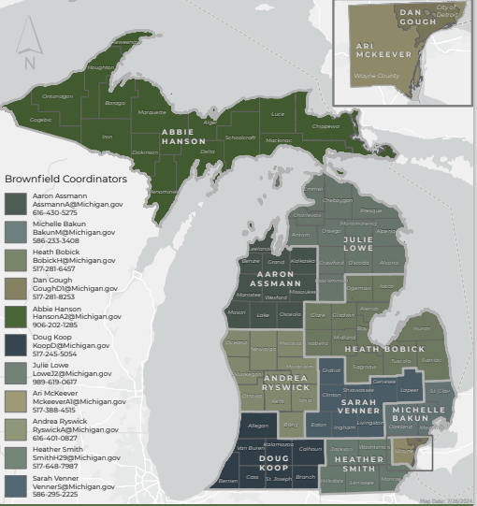
brownfield coordinator’s Role
EGLE Brownfield Coordinators
Local Enviro. Contact
Facilitate Projects
Outreach & Educate
Notes:
EGLE has BF coordinators across the state
BF coordinators communicate with LUGs, the general public, developers, and environmental consulting firms regularly
BF coordinators are willing and happy to field any questions you may have related to brownfield redevelopment or EGLE programs, in general

Slide 4
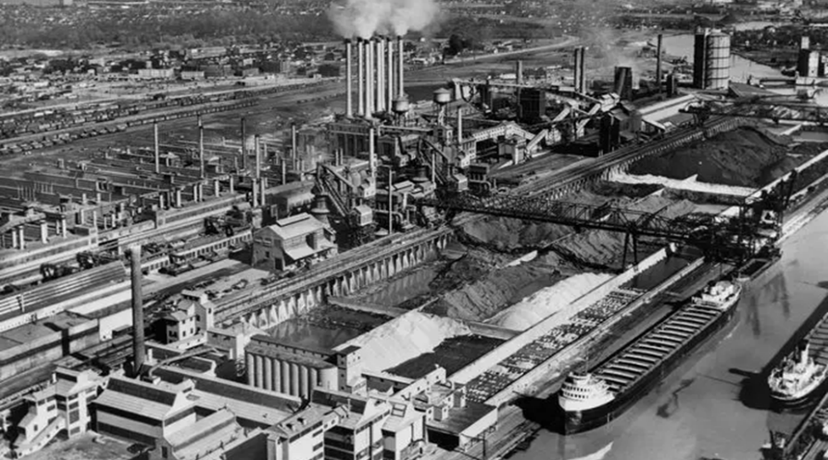
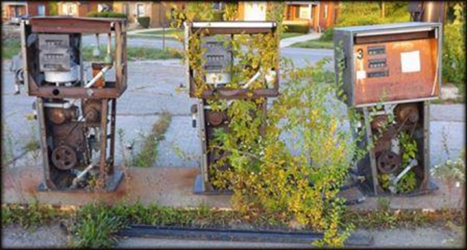

What IS AN EGLE BROWNFIELD?
Photo source: ReviseSociology.com
Property that is KNOWN or SUSPECTED to be contaminated

Slide 5
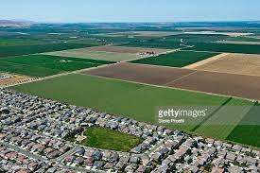
Purpose of Brownfield program
Reduce Sprawl
Address Contamination
Revitalize Communities

Slide 6
Typical Brownfield Project Team
EGLE (brownfield and district staff)
Local government (LUG--needs to be all in)
Brownfield redevelopment authority (sometimes)
Developer
EnvironmentalConsultant(s)
MEDC (sometimes)
MSHDA (sometimes)

Slide 7
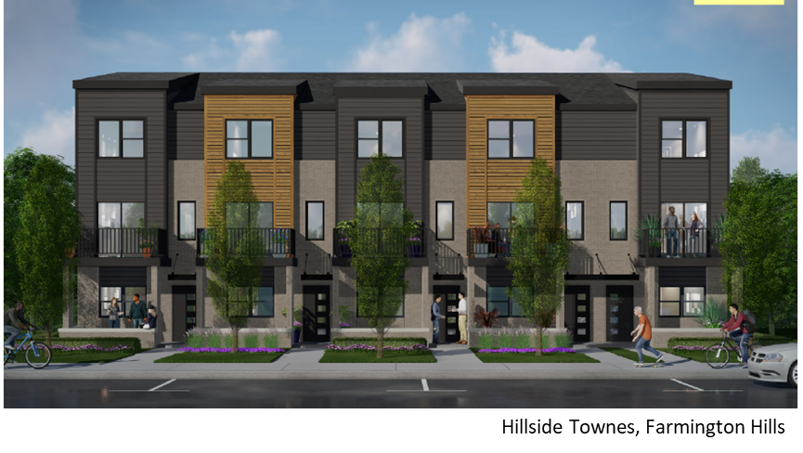
We share a common goal
Safe & Successful Development
LUG
EGLE
Developer

Slide 8

Egle Brownfield incentives
Photo source: ReviseSociology.com
Brownfield Site Assessments ($1M/yr)
Brownfield Grants ($15M/yr)
Brownfield Loans ($5M/yr)
Brownfield Tax Increment Financing
Notes:
EGLE is funded by the State and receives around $20M across three main categories. Also take part in TIF.

Slide 9
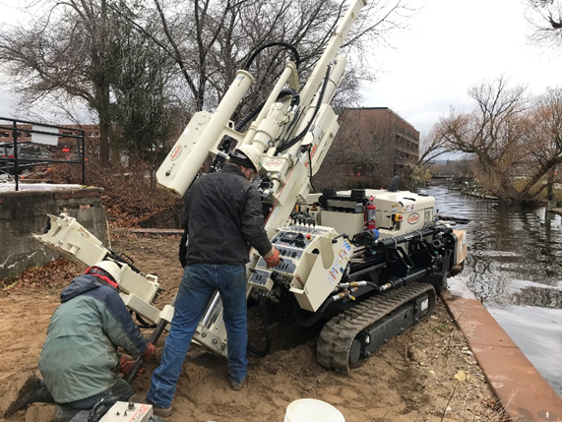
Brownfield Assessments
PURPOSE
Liability protection (BEA)
Help determine how to make the property safe for reuse (Due Care)
Evaluate environmental condition of the property
Cornwell Project Traverse City

Slide 10
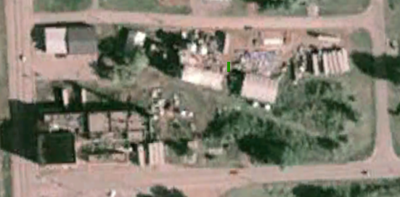
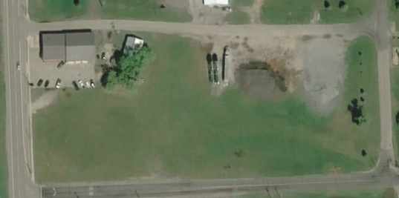
Brownfield Assessments
Photo source: ReviseSociology.com
ELIGIBILITY
Who
LUGs
Purchasers
Owners
Activities
Hazardous Materials Survey
Phase I / II
BEA
Due Care Planning
Non-Profits
Developers
Google Earth – 12/2005 Image
Google Earth – 9/2020 Image
Former Sheridan Carnation Site

Slide 11
What is a BEA?
Photo source: ReviseSociology.com
What is it?
Who needs it?
Government or private entities purchasing, leasing, or foreclosing on property.
Liability protection against contamination that occurred in the past.
Consult your environmental attorney.
Baseline Environmental Assessment
Notes:
Consult an environmental attorney!

Slide 12

What is Due Care?
Photo source: ReviseSociology.com
Owner and operator’s legal responsibility to protect human health on the property.
Regardless of who caused the contamination!
Notes:
Examples: Installing vapor mitigation system in old dry cleaner or gas station; remove contaminated soils before building a playground.

Slide 13
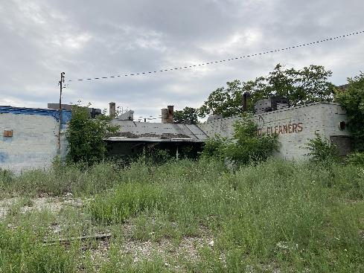
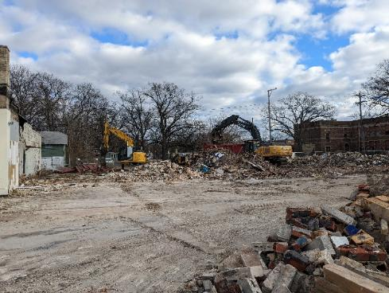
Brownfield grants & loans
OVERVIEW
1 project per year up to $1M grant, $1M Loan
Contaminated (Facility)
Redevelopment Planned
Loan Terms
15 yrs; 5 yrs payment/interest free; 1.5% interest thereafter
Shoppes on Sherman
City of Muskegon Heights

Slide 14
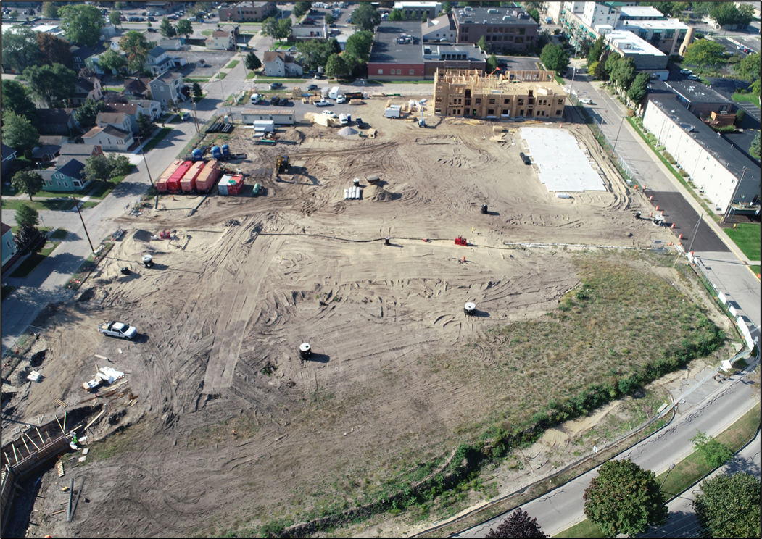
Brownfield grants & loans
Photo source: ReviseSociology.com
ELIGIBILITY
Who
LUGs (applicant)
Activities
Assessment
Due Care (make it safe)
Response Activities (clean up)

Slide 15
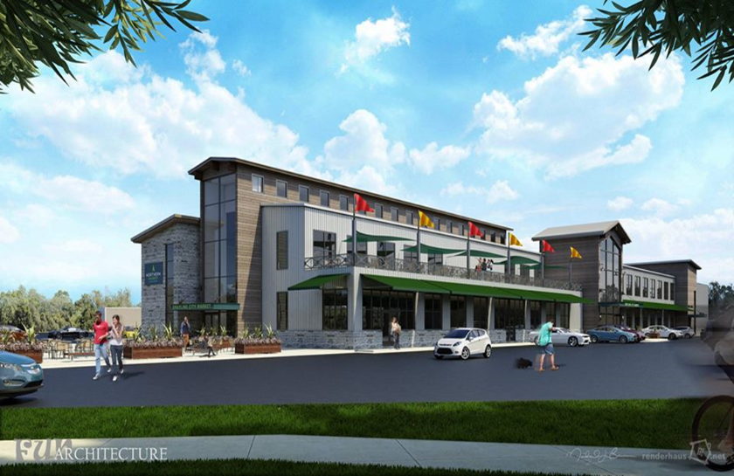
Brownfield Tax Increment Financing (TIF)
OVERVIEW
Local program (Not EGLE)
Based on increased taxable value
Reimbursed over time (up to 30 yrs)
Works great with Loans

Slide 16
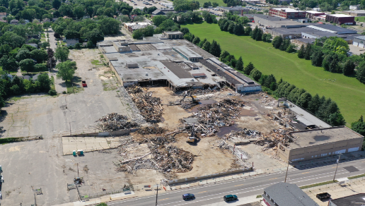
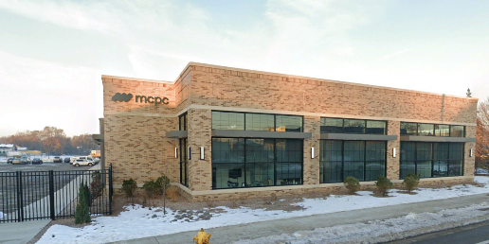
Brownfield Tax Increment Financing (TIF)
Photo source: ReviseSociology.com
ELIGIBILITY
Who
LUGs (applicant)
Activities
Assessment
Due Care (make it safe)
Response Activities (clean up)
Photo Taken During Demolition
Google Earth – 10/2024 Image
1601 Madison Ave. – Former Dexter Lock

Slide 17
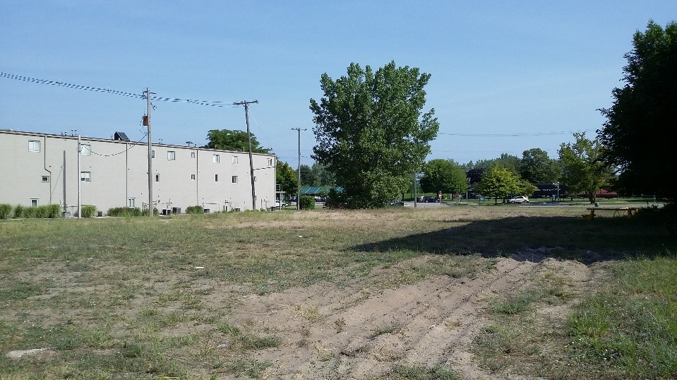
brownfield SUCCESS
Peerless Flats- Grand Haven
Former Industrial Site
BEFORE
Vacant since 1980s
Contaminated from metal products mfg.
Notes:
1920s-1980s – Metal products manufacture/metal stamping business

Slide 18
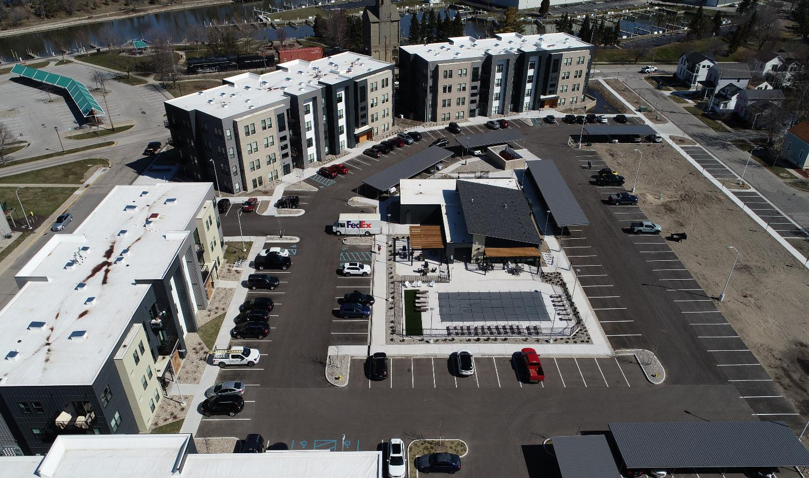
brownfield SUCCESS
Peerless Flats – Grand Haven
$900,000 BF Grant, $900,000 BF Loan, $1.1M TIF
AFTER
$22.8 M investment, 3 jobs
Residential
Notes:
VMS, Soil t/d, contaminated GW treatment and disposal

Slide 19
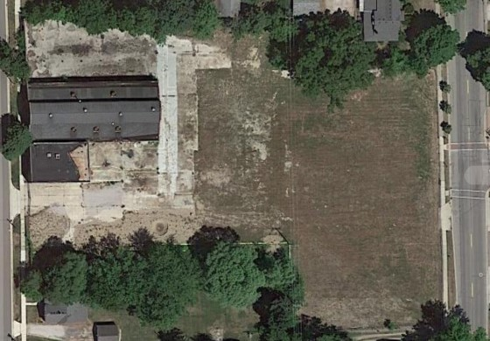
brownfield in progress
Main Street park, chelsea
Heavy Industrial Use
BEFORE
Contaminated with oils, gasoline, chlorinated solvents, etc.
Notes:
Chelsea Screw Company and Federal Screw Works occupied the property for manufacturing and machining operations from approximately 1917 to 2005. Operations included the use of cutting, lubricating, and hydraulic oils, fuel oil diesel, kerosene, and gasoline, as well as chlorinated solvents. At least eight underground and aboveground storage tanks existed on-site. Three USTs remain at the property. The property has been vacant since FSW stopped operating in 2005.
EGLE grant and loan funded activities are limited to assessment, due care, and demolition activities, which are not the responsibility of the liable party. The Jackson District office has reviewed the proposed brownfield funding and agrees there will be no activities funded by grant or loan that would be considered to be benefiting a party responsible for causing a release.
FSW – Could possibly Fence and leave as is
The scope of work of the grant and loan funding includes:
A pre-demolition asbestos and hazardous materials survey
Demolition
Due care planning and documentation
Contaminated soil excavation, transportation, and disposal
Installation of demarcation fabric and clean backfill to prevent direct contact exposure
Contaminated soil posing a direct contact risk is present throughout the property. Redevelopment plans call for the removal of the existing surface soils and installation of a clean soil cap and/or impervious site features to prevent contact with contaminated soils.
City bring in other funding sources

Slide 20
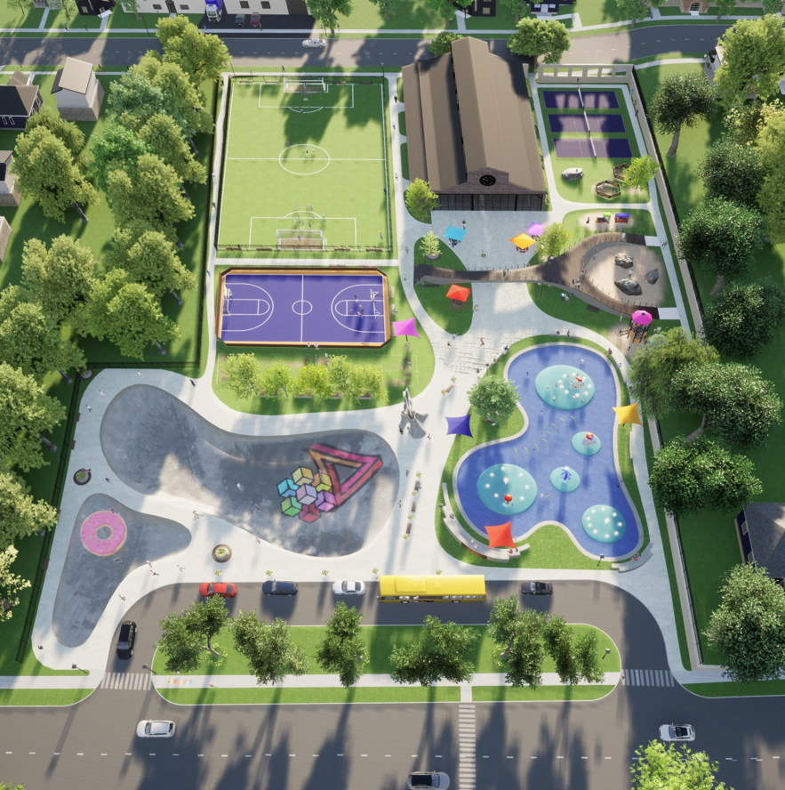
brownfield in progress
Main Street park, chelsea
AFTER
  $1,000,000 BF Grant,
  $5M investment
  Public park: climbing wall, pickle ball, soccer, skate bowl, splash pad
Notes:
Chelsea Screw Company and Federal Screw Works occupied the property for manufacturing and machining operations from approximately 1917 to 2005. Operations included the use of cutting, lubricating, and hydraulic oils, fuel oil diesel, kerosene, and gasoline, as well as chlorinated solvents. At least eight underground and aboveground storage tanks existed on-site. Three USTs remain at the property. The property has been vacant since FSW stopped operating in 2005.
EGLE grant and loan funded activities are limited to assessment, due care, and demolition activities, which are not the responsibility of the liable party. The Jackson District office has reviewed the proposed brownfield funding and agrees there will be no activities funded by grant or loan that would be considered to be benefiting a party responsible for causing a release.
FSW – Could possibly Fence and leave as is
The scope of work of the grant and loan funding includes:
A pre-demolition asbestos and hazardous materials survey
Demolition
Due care planning and documentation
Contaminated soil excavation, transportation, and disposal
Installation of demarcation fabric and clean backfill to prevent direct contact exposure
Contaminated soil posing a direct contact risk is present throughout the property. Redevelopment plans call for the removal of the existing surface soils and installation of a clean soil cap and/or impervious site features to prevent contact with contaminated soils.
City bring in other funding sources

Slide 21
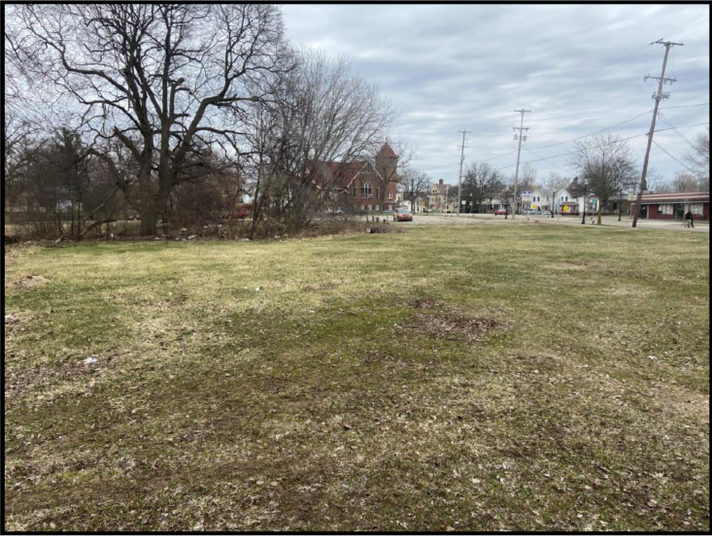
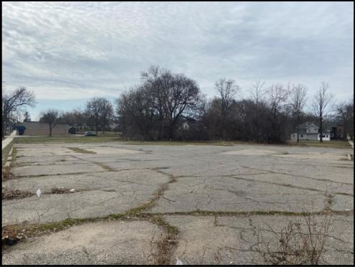
brownfield in progress
The Greenwood - jackson
BEFORE
7 parcels.
Many vacant 20-30 years
Contamination from former gas station/ auto shop
Notes:
Block away from Hinkley’s Bakery.

Slide 22
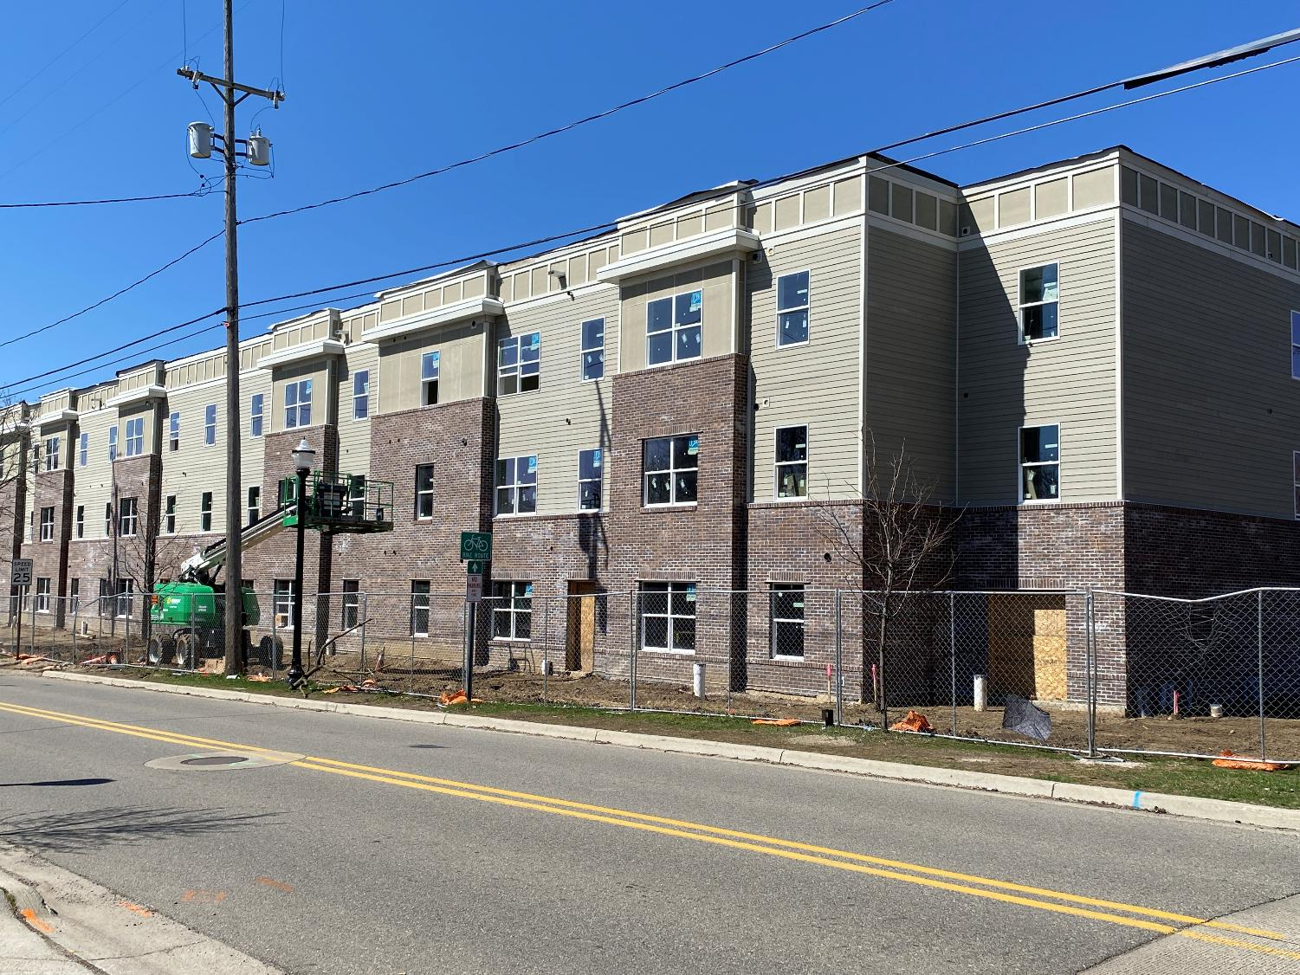
brownfield in progress the greenwood Jackson
Notes:
Triterra & Pivotal

Slide 23
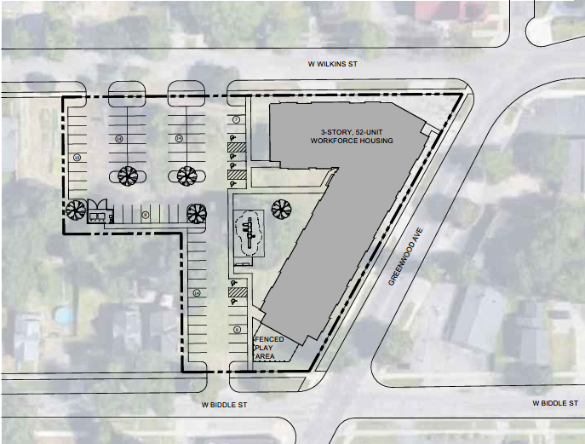
brownfield in progress the greenwood Jackson
$675,000 BF Grant
AFTER/COMING SOON!
Transport & Disposal of contaminated soils and underground storage tank
52 units of workforce housing
Vapor mitigation system
Notes:
Triterra & Pivotal

Slide 24
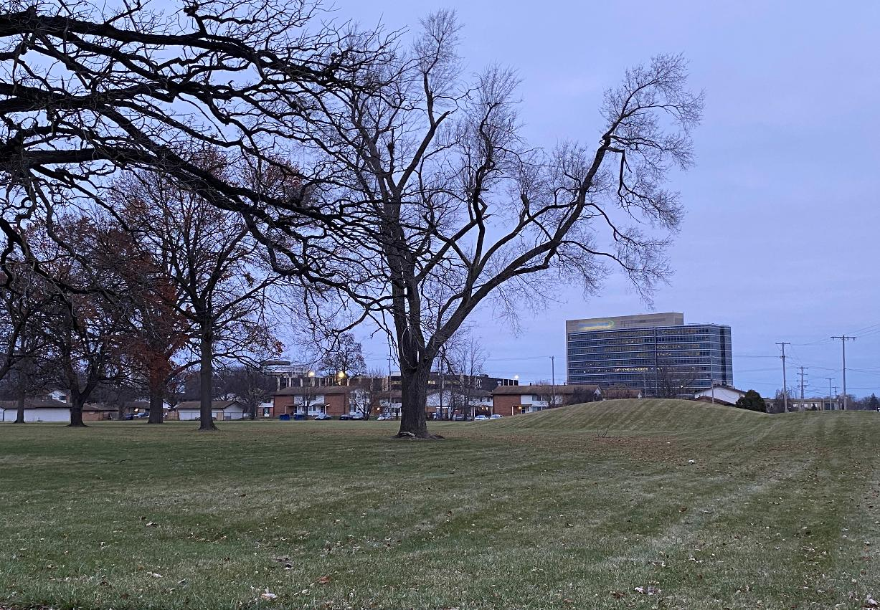
Future Brownfield funding?
Commercial Development
  Future development to address the need for community grocery, banking, and health & wellness services

Slide 25
Key Take Aways
Brownfield projects exist everywhere
Projects do not have to die due to lack of funding
Contact EGLE early in the process
Call us any time there are added development costs due to environmental conditions
Image Credit: giphy.com

Slide 26

Questions?
Heather Smith
Jackson District Brownfield Coordinator
EGLE Remediation & Redevelopment Division
Brownfield Section
Smithh29@Michigan.gov
517-648-7987

