Slide 1

Brownfield Redevelopment Tools and Resources
Jackson County Brownfield Redevelopment Summit
May 1, 2025
Notes:
Anne
Discuss presentation content :
Brownfield Basics review
Housing TIF
Financial issues with creation of housing and how the tools can potentially help
Leave time for questions and discussion
Using TIF for housing is a very new concept allowed by the passage of PA 90 of 2023 which amended Act 381. We are all still learning and understanding MSHDA’s requirements.

Slide 2
Presentation Outline
Jackson County Brownfield Redevelopment Authority
Brownfield Basics and Brownfield Tax Increment Financing
Overview of Brownfield Eligibility and Eligible Activities
Brownfield Processes

Slide 3


Slide 4
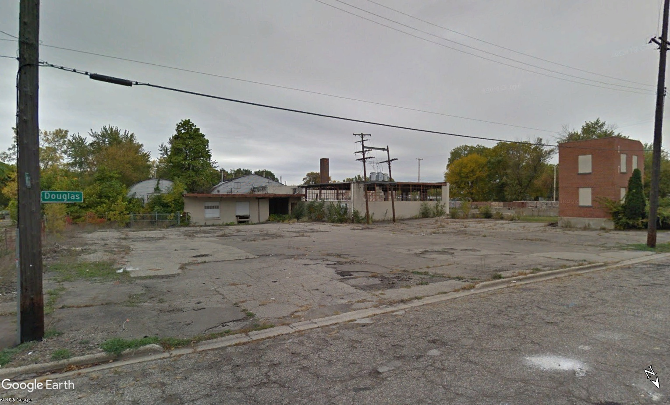
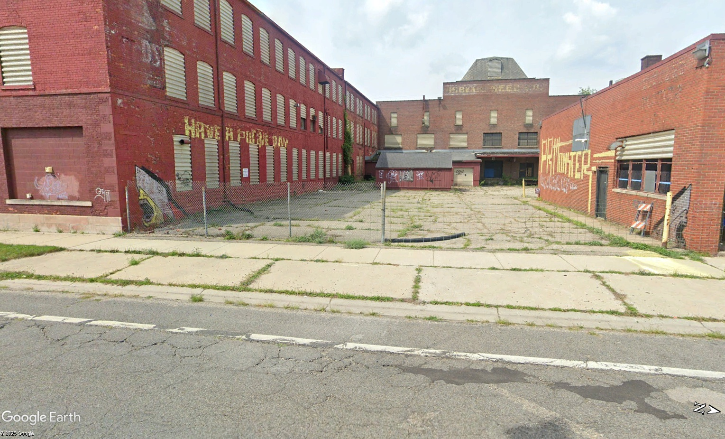
Brownfield Sites

Slide 5
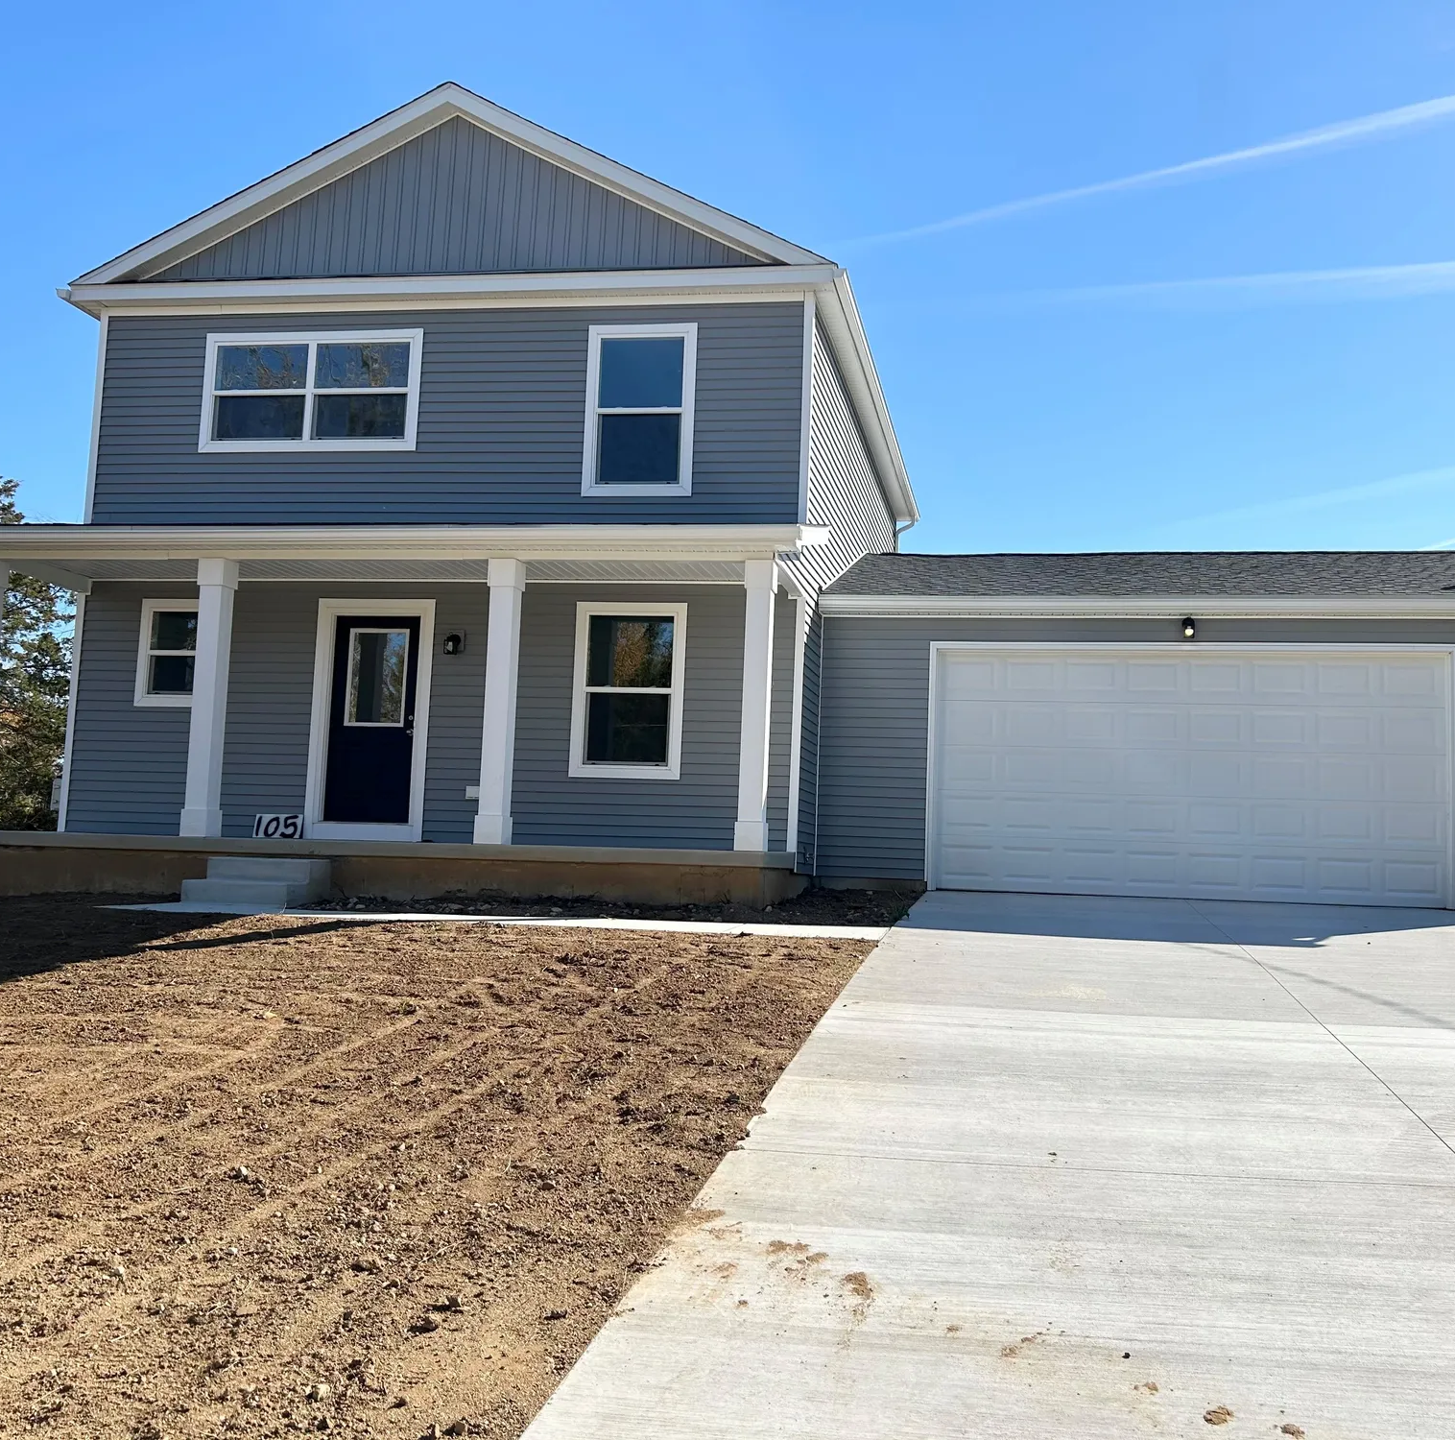

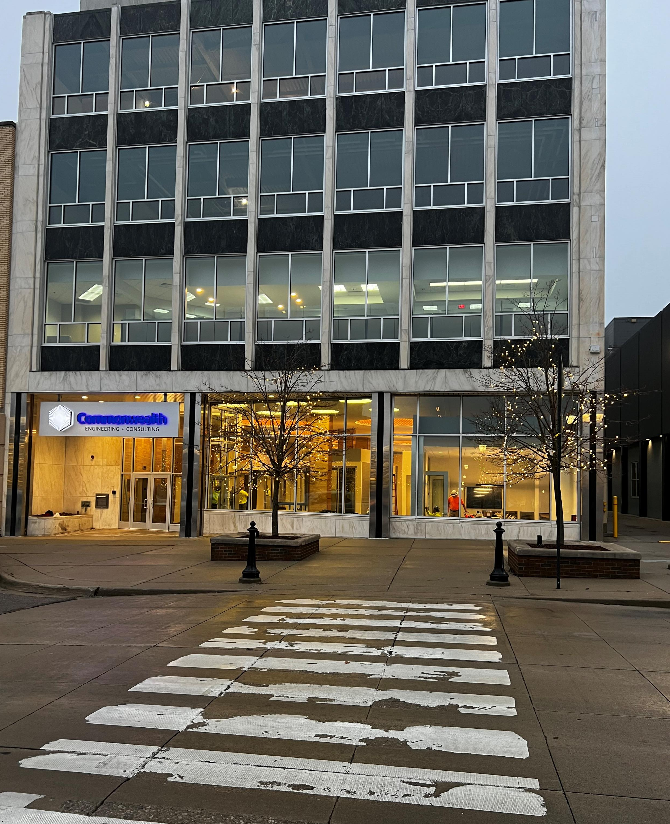
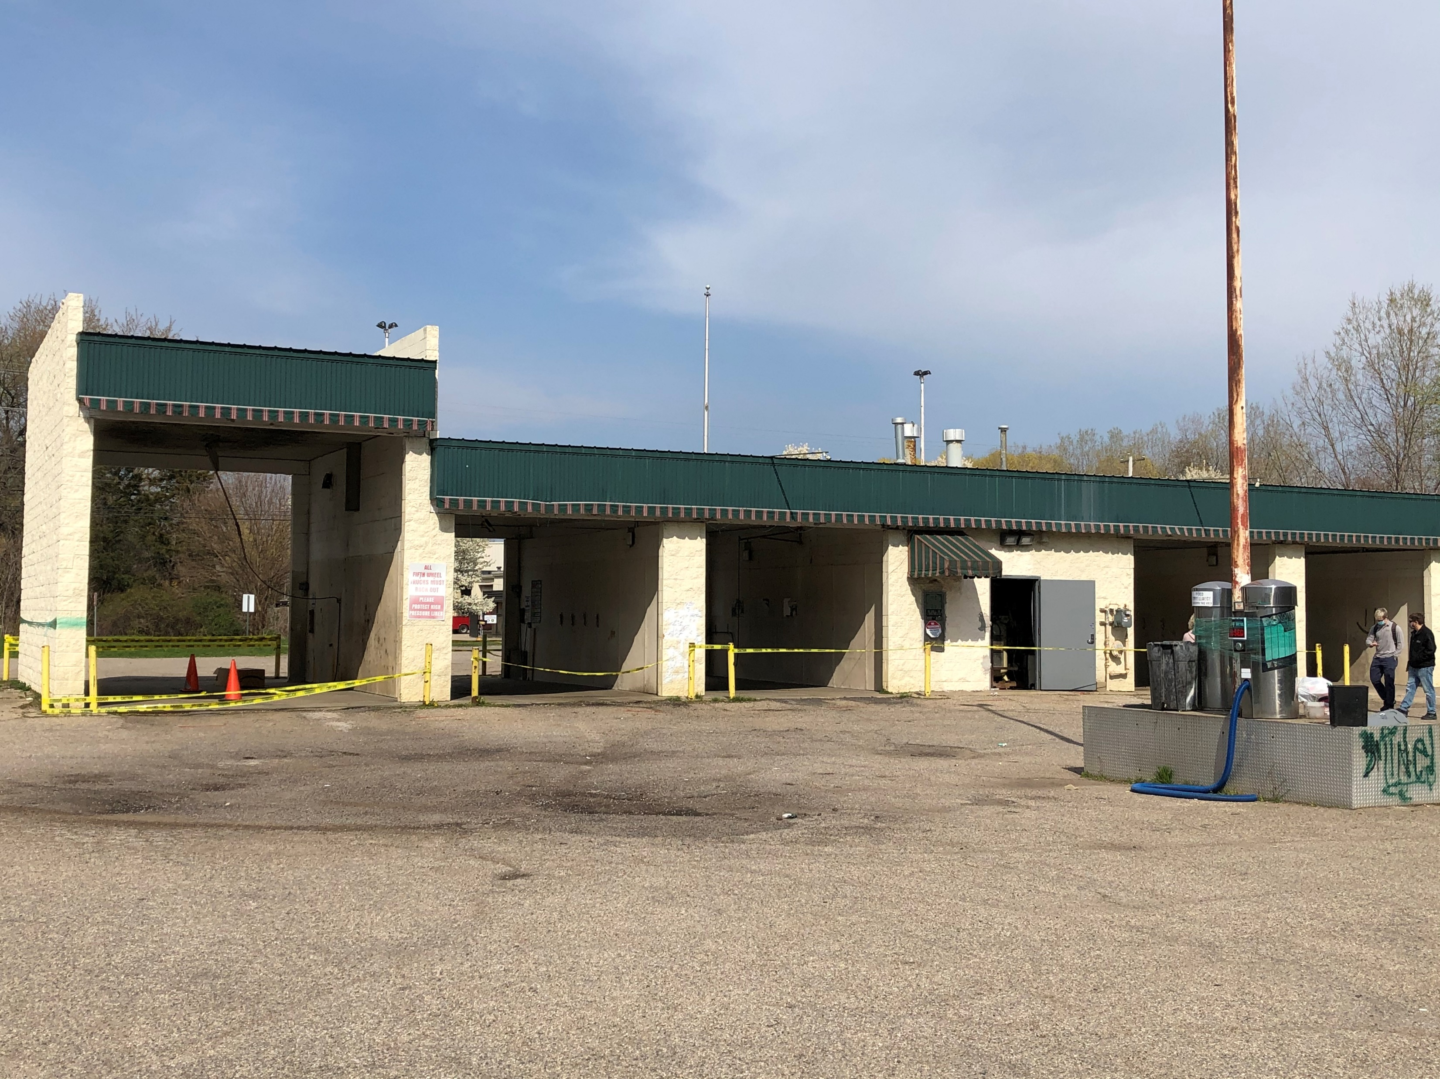
Also Brownfield Sites

Slide 6
Brownfield Redevelopment is Economic and Community Development!
Eligible Property:
Contaminated Property (“facility”)
Functionally Obsolete Property
Blighted Property
Historic Resource
Land Bank Authority Properties
Transit Oriented Property
Property Contiguous and Adjacent to a Brownfield
Housing Property

Slide 7

Brownfield Basics
  Act 381 – Brownfield Redevelopment Financing Act 1996 PA 381, as amended
  Enacted to encourage brownfield redevelopment
  Controlled through Local Units of Government – Municipality and/or County
Primary use:
  Create Brownfield Redevelopment Authorities
  Provide funding/financing of brownfield eligible activities that create a project financing gap
  Create Brownfield Plans for tax increment financing
  Conduit for State/Federal Grants and Loans
  Collaboration with Local Units of Government, Authorities, State Agencies, Citizens, and Local Economic Development Agencies to address local and project needs.
Notes:
Anne

Slide 8
Jackson County Brownfield Redevelopment Authority
  Established by the County Board of Commissioners in 1999
  Authority run by a Board of Directors, staffed contractually by Accelerate Jackson, and supported with contractual technical service provider(s).
  Awarded multiple federal U.S. EPA grants over the years
Year | Amount | Type
1999 | $350,000 | Assessment
2001 | $1,000,000 | Revolving Loan Fund
2004 | $200,000 | Assessment
2008 | $400,000 | Assessment
2009 | $1,000,000 | Revolving Loan Fund
2015 | $400,000 | Assessment
2020 | $300,000 | Assessment
TOTAL | $3,650,000

Slide 9
Jackson County Brownfield Redevelopment Authority
  Notable projects:
    Klavons, re-alignment of airport landing strip, demolitions (Acme site, former Consumers Energy Headquarters, former Riverwalk Hotel), County Fairgrounds, Armory, Biggby Coffee, Fern Ventures/New Kutcha’s Party Rental, Jackson Self Storage, Ultimate Auto Repair, and many more
  Currently managing 10 active Brownfield Plans
  Several completed projects with developers fully paid
  Authority actively seeks reimbursement of its expenses and is building a Revolving Loan Fund to support future projects.

Slide 10
Brownfield Tax Increment Financing
  Property must be eligible under Act 381
  The project needs to result in an increase in Taxable Value
  The increase in Taxable Value creates new property tax revenues which can be used to reimburse “eligible activities”
  Can work with other tax incentives, grants, loans, etc.
Notes:
Jeff

Slide 11
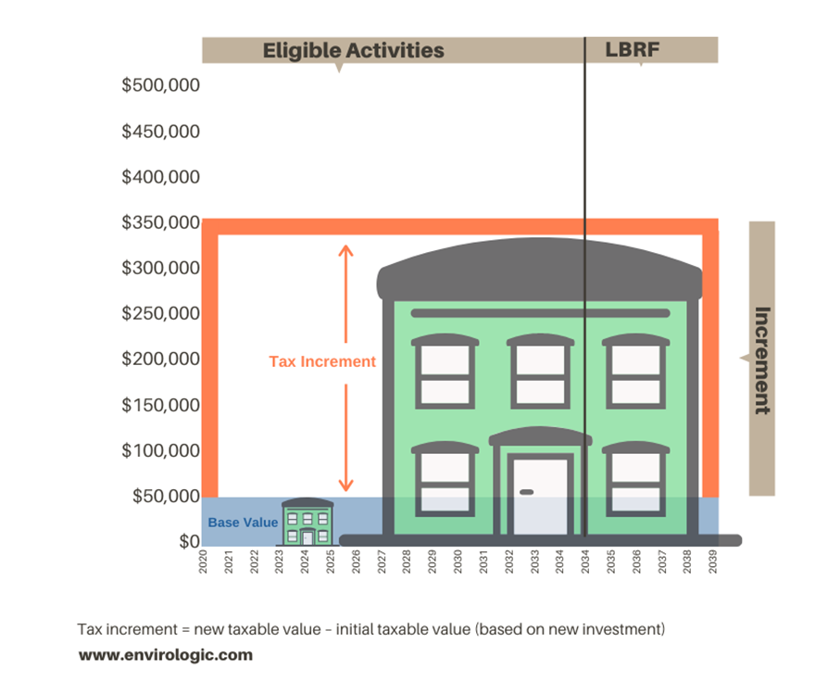
Tax Increment Financing
The New (Incremental) Taxes are used to reimburse the party that financed (Developer and/or Authority) the Eligible Activities Described in the Brownfield Plan.
  Tax Increment = new taxable value – initial taxable value (based on new investment)
  Plans limit cost of Eligible Activities to be reimbursed and the amount of time for reimbursement (Plan – 35 years; TIF – 30 years)
  Once the Plan reaches one of these limits, it is ended, and all future tax increment accrues to the individual taxing jurisdictions.
Notes:
Anne

Slide 12

What are “Eligible Activities”? (Redevelopment Expenses)
Brownfield Plan/Act 381 Work Plans
  EGLE* (Department of Environment, Great Lakes and Energy) Department Specific Activities (Environmental):
  Phase I and II ESAs, BEAs, Due Care activities, response activities, removal and closure of USTs, disposal of solid waste, dust control, specialized foundations, removal and disposal of lake or river sediments, industrial cleaning, certain sheeting or shoring, lead, mold or asbestos abatement
  Demolition that is required to address environmental site issues
  Infrastructure improvements and site preparation for landfill facilities that meet certain criteria
  MSF* (Michigan Strategic Fund) Activities (Non-Environmental):
    Demolition, lead and asbestos abatement
    Site preparation (**Core Communities, Land Bank)
    Public infrastructure (**Core Communities, Land Bank)
  MSHDA* (Michigan State Housing Development Authority) Activities (Housing)
  Preparation of Brownfield Plans and Work Plans
  Brownfield Plan and Work Plan implementation
  Administrative costs of the BRA
  Interest Expense
Notes:
Jeff

Slide 13
Brownfield Plan Approval Process
  Local Approval:
  Developer proposes project and develops plan
  Brownfield Redevelopment Authority reviews plan and recommends adoption by County Board of Commissioners (BOC)
  BOC adoption subject to local unit of government approval where the project is occurring and a public hearing by the County Board of Commissioners
  State Approval:
  Developer creates a work plan
  Brownfield authority and state (MSHDA, MEDC, and/or EGLE) approve work plan
Notes:
Jeff

Slide 14
Things to remember:
  No taxing jurisdiction will get less money under a brownfield plan than it does prior to approval of the brownfield plan
  Only the taxes from the new development are captured
  Per pupil school funding is not affected when school tax millages are captured in a Brownfield Plan
  Reimburses eligible brownfield costs only if project creates tax increment from new investment and the taxes are paid
  Multiple jurisdictional approval process and publicly vetted
  Brownfield Plans help leverage other funding programs and incentives. Supports projects that are consistent with local zoning, Master Plans, etc. – a public-private partnership that creates win-win-win outcomes.
Notes:
Anne

