Slide 1
Notes:
All Audiences
Will need Graphics Update

Slide 2
Notes:
All audiences
Need new Graphic

Slide 3
Brownfield Basics Training Objectives
Gain an understanding of how the Brownfield Tax Increment Financing (TIF) Program revenues are generated
Become familiar with the concepts of eligible property and the eligible activities that are utilized for TIF
Learn how to identify the total incentive request and the state/local portions of that request
Notes:
EDIS Staff
CDM
BDM

Slide 4
Brownfield Basics Training Objectives
Gain an understanding of how the Brownfield Tax Increment Financing (TIF) and
Become familiar with TIF Program timelines
Become familiar with TIF Program paramaters and limitations
Notes:
Leadership

Slide 5
What is a Brownfield?
A property or building that is contaminated (facility), functionally obsolete, blighted, historic resource, or adjacent and contiguous. If a property(s) meet one or more of the above criteria, and included in a Brownfield Plan, it is considered Eligible Property.
Can be industrial, commercial, residential, etc. as long as it meets one of the above criteria.
MEDC administers non-environmental aspects of redevelopment.
EGLE administers environmental aspects of redevelopment.
MSHDA administers specific housing development activites included in redevelopment.
Notes:
All Audiences

Slide 6
Role of the MEDC
Administers non-environmental portion of the Brownfield Redevelopment Program.
Includes redevelopment activities that are not related to contamination, but contamination may be present on the property.
Provides support to MSF Board.
Both MEDC and EGLE review the project if there are environmental and non-environmental issues on the project site, but approve it separately.
MSF approves via Board resolution, or Board Chairperson approval if it is a stand-alone project with state capture under $1,000,000.
MSHDA reviews the project if there is a request for reimbursement of Housing Development Activities
Three Programs that Utilize Brownfield Qualification:
Act 381 Tax Increment Financing (TIF)
Preparing the site for development. A few hard construction costs.
Community Revitalization Program (CRP)
Transformational Brownfield Program
Notes:
EDIS
CDM
BDM

Slide 7
Housing TIF
MEDC and MSHDA may see requests for support for similar projects
Housing-Only projects that contain an affordable component and are requesting Brownfield TIF support must pursue MSHA approval only.
If development is mixed use and contains an affordable component, the developer should pursue approval through the agency in which the TIF reimbursement can be maximized.
Notes:
Leadership
EDIS
CDM

Slide 8
Brownfield TIF:What is Tax Increment Financing?
Act 381 Work Plans/Combined Plans are Tax Increment Financing (TIF) Plans
Key to TIF is the increment, or increase in property value after a project is completed.
How it works:
- Developer makes improvements to a property, which raises the taxable value and increases the tax revenue collected from the property.
- The pre-redevelopment - or base value - remains as a revenue stream to the jurisdiction, the increased value or “increment” is captured by the jurisdiction to reimburse the developer for Brownfield eligible activities.
- Win-win situation; developer is paid back for increased costs due to Brownfield conditions, jurisdiction gets increased tax values following the conclusion of developer reimbursement.
Notes:
EDIS Staff
CDM
BDM

Slide 9
Brownfield TIF: Revenue Mechanism
Act 381 Work Plans/Combined Plans are Tax Increment Financing (TIF) Plans
Tax Increment Revenue is generated by the increase in taxable value as development occurs.
MSF considers and may approve School (sometimes called State) tax capture to support a project.
Notes:
Leadership

Slide 10
Brownfield TIF: Revenue Mechanism
Structure
Not a Stand-alone incentive awarded by MSF
Must be in conjunction with the approval of a Brownfield Plan by the local Brownfield Redevelopment Authority, which includes the appropriate local capture
Total incentive is a partnership between the state and local unit of government
Financial Limitations
Revenue is generated by property tax increment, so there is no allocation limit.
Reimbursement is statutorily allowed up to a maximum of 30 years, which creates a natural cap.
Notes:
Leadership

Slide 11
How TIF Works
Notes:
EDIS Staff
CDM
BDM

Slide 12
What are the Primary Documents?
Brownfield Plan – This is the document approved at the local level that describes the project and eligible activities, sets the maximum amount of eligible activity costs, and identifies the eligible property the project will occur on.
Act 381 Work Plan/Combined Plan – This is the document that will be considered for approval by the MSF. This identifies eligible activities and eligible property, but more importantly, provides the specific amount of eligible activity costs requested for State support. The level of state participation is based on 24 mills (school operating and state education tax) while the remaining local participation is based on all available local millages.
Notes:
Leadership
EDIS Staff
CDM
BDM

Slide 13
Brownfield Terminology: Eligible Property
Property must meet at least one Qualifying Criteria:
Facility - Contamination exceeds residential criteria.
Functionally Obsolete - Unable to perform the function it was originally intended for (need level III or IV assessor).
Blighted - (1) Attractive nuisance to children, utilities permanently disconnected, fire hazard, subsurface debris
(2) Designated by local government.
Historic – In a local historic district or is on State or National Register.
Can include property parcels that are adjacent or contiguous to eligible property.
Also includes Land Bank Owned (tax reverted), Targeted Redevelopment Area, Transit Oriented Property and Transit Oriented Development.
Housing Property – Eligible Property qualification used only by MSHDA
Notes:
EDIS Staff
CDM
BDM

Slide 14
Brownfield Terminology: Eligible Property
Property must meet at least one Qualifying Criteria:
EGLE eligible property qualifier
Facility (Contaminated) only
MSF/MEDC eligible property qualifiers
Facility, Functionally Obsolete, Blighted, Historic, Adjacent or Contiguous to eligible property, Land Bank Owned (tax reverted), Targeted Redevelopment Area, Transit Oriented Property and Transit Oriented Development.
MSHDA eligible property qualifier
Housing Property only
Notes:
Leadership

Slide 15
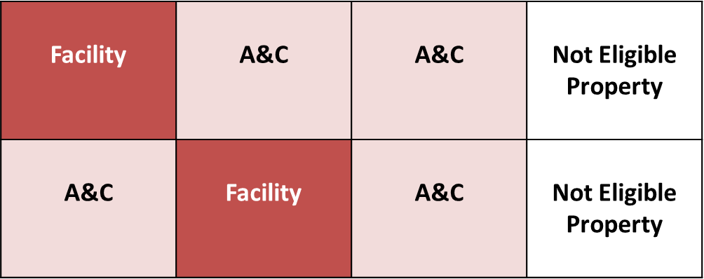
Eligible Property: Adjacent & Contiguous
Parcel = legal description
Notes:
EDIS Staff
CDM

Slide 16
Brownfield Terminology: Eligible Activities
Traditional MSF Activities:
1. Infrastructure Improvements
2. Building and Site Demolition
3. Lead, Asbestos, and Mold Abatement
4. Site Improvements
*Reimbursement cannot occur for vertical construction except for
parking decks or integrated vertical parking.
Notes:
Leadership

Slide 17
Brownfield Terminology: Eligible Activities
MSF Activities:
1. Infrastructure Improvements
Within public right-of-way or easement
Sewer & water, lighting, paving streets, etc.
Exception for storm water management and parking decks on private land
2. Building and Site Demolition
Whole or partial buildings, interior or exterior
Old site infrastructure like concrete work, foundations, abandoned utilities, etc.
3. Lead, Asbestos, and Mold Abatement
Notes:
EDIS Staff
CDM
BDM

Slide 18
Eligible Activities Continued
4. Site Preparation
Prepares the site for development: clearing, soil removal (non-contaminated) and leveling, temporary facilities, etc.
5. Assistance to a Land Bank or Local Government Unit.
Clearing title, purchase costs, acquisition for economic development purposes.
6. Contingency (up to 15% ) and Simple Interest (up to 5%).
On eligible activity costs.
7. Brownfield & Work Plan implementation costs (up to $50,000).
8. Brownfield & Work Plan preparation costs (up to $30,000).
Notes:
EDIS Staff
CDM
BDM

Slide 19
Act 381: Administrative Requirements
Core Community designation determines available activities;
Core: All eligible activities. The Core Community list can be found here (miplace.org).
Non-core: Lead, Asbestos & Mold Abatement and Demolition only.
Brownfield Redevelopment Authority (BRA) - develops Brownfield Plan and subsequent Work Plan.
Must have Local or County approval of Brownfield Plan to authorize tax capture.
A County BRA must obtain concurrence for the TIF revenue capture from the affected city or township.
The BRA must be in compliance with annual reporting to the MEDC in order for a project to be considered. Please consult with Brownfield staff to determine compliance.
Notes:
EDIS Staff
CDM
BDM

Slide 20
What’s the Process Timeline?
A BRA approves a Brownfield Plan
The Municipality and/or County approves the Brownfield Plan (1-2 months)
The BRA submits the Work Plan through the BDM/BDPM for consideration at Project Review Meeting
Brownfield Staff Reviews and Prepares Work Plan for MSF Consideration (45-60 Days)
Once Work Plan is approved by MSF, no more administration is conducted by MEDC staff. The BRA will report status annually by August 31 to the MEDC/EGLE/MSHDA.
Notes:
BDM

Slide 21
Notes:
Need New Graphic

Slide 22
Notes:
Need Updated Graphic

